Slide 1
SQL Window Aggregation
Jignesh M. Patel November 1, 2023

Slide 2
Reading List
V. Leis, K. Kundhikanjana, A. Kemper, and T. Neumann. Efficient Processing of Window Functions in Analytical SQL Queries. VLDB 2015
https://www.vldb.org/pvldb/vol8/p1058-leis.pdf
Y. Cao, C.-Y. Chan, J. Li, and K.-L. Tan. Optimization of analytic window functions. VLDB 2012
http://vldb.org/pvldb/vol5/p1244_yucao_vldb2012.pdf

Slide 3
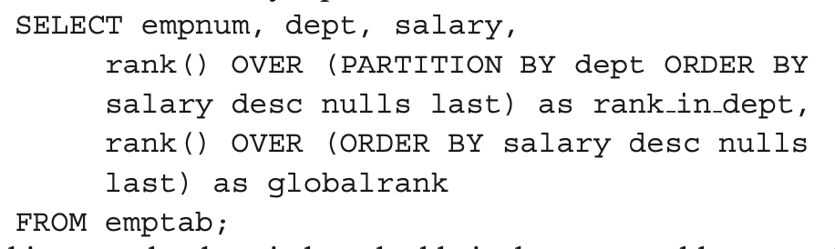
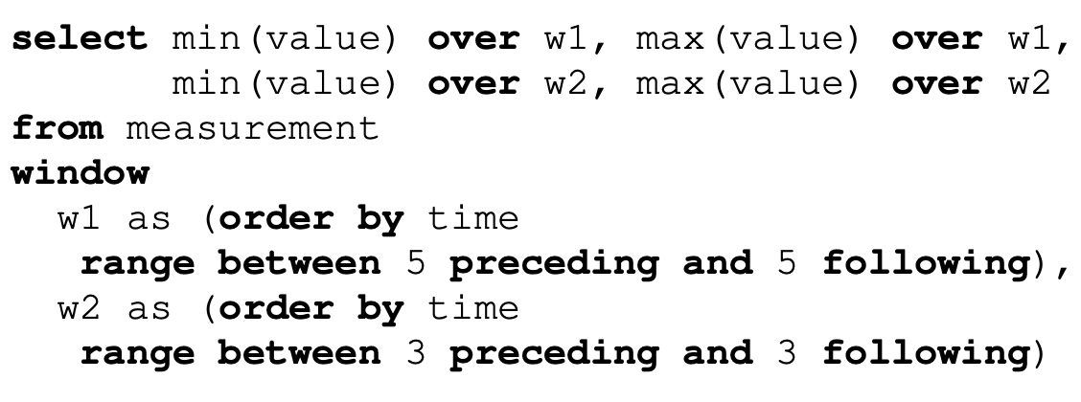
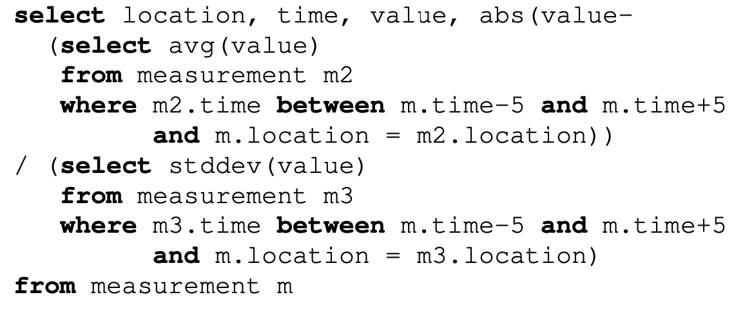
Window Aggregation: Examples

Slide 4
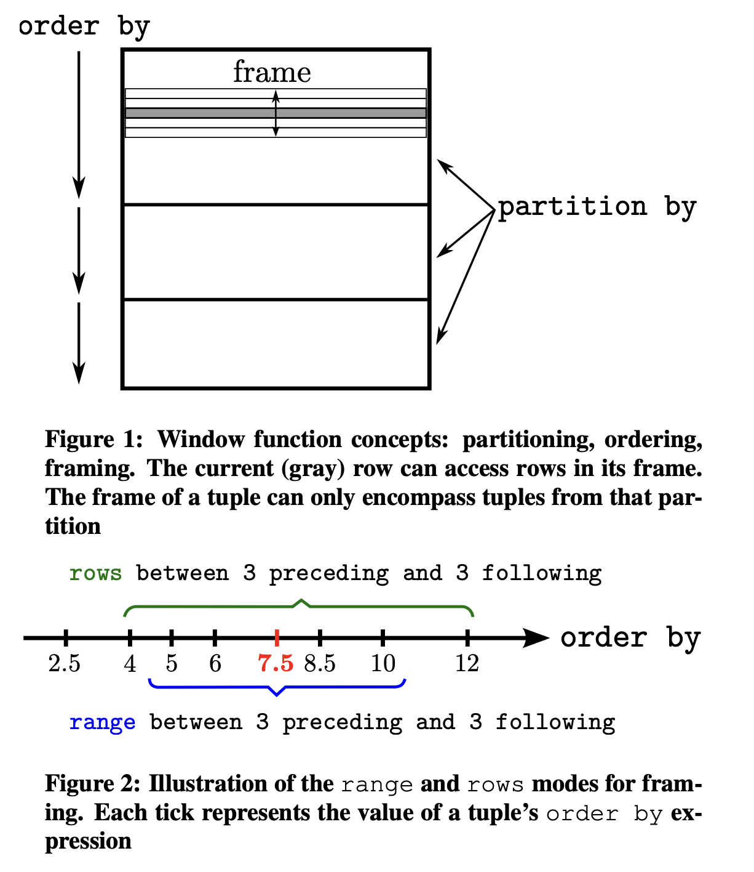
Window Aggregation: Execution model

Slide 5
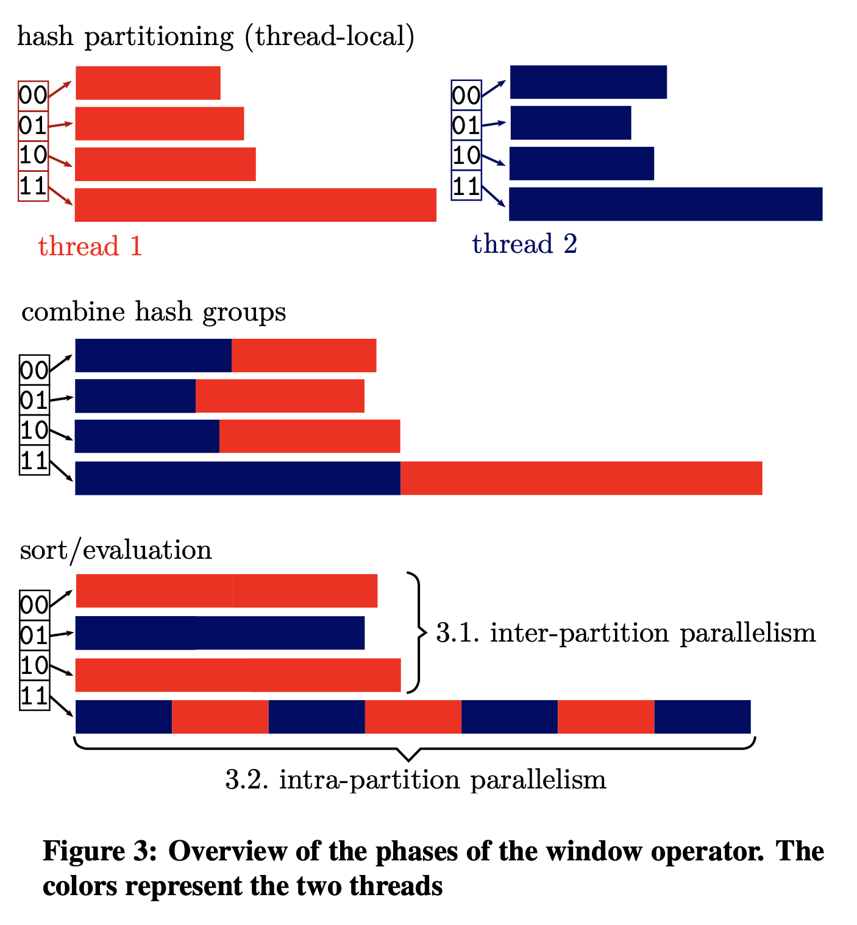
Observations
The partition columns → need some permutation of these columns in a partition. Could over partition (add new columns) but then have to coalesce.
The order columns → need all rows in a partition sorted by this group of columns.
The framing calculation → need to move back and forward from the “current” row to create the output.

Slide 6
Window Query: Evaluation Strategies / Cao et al. VLDB’12
A full-sort on the (partitionCols, orderCols) columns enables computing the framing component locally and efficiently (sorting is already done).
Framing
Don’t need a full-sort, but a hash on partition partitionCols is enough, so can hash on partitionCols and sort within each partition.
Faster in many cases as the sort is on a smaller set of data, and each sort may fit in memory
Window clauses come in bunches → A single query may have multiple window clauses.
Opportunities to optimize this part. Can be cast as an cover set-based optimization scheme to find the right “window chain.”

Slide 7
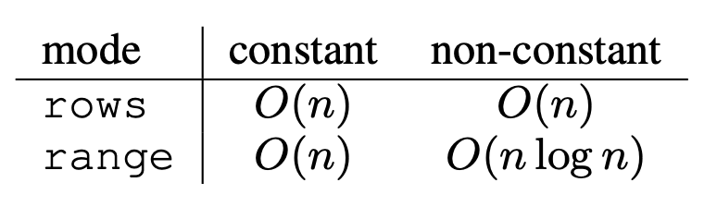
Framing
Row mode is easy (and fast) just need to go back/forward some # of rows.
Range mode is harder, especially when the bounds are not constant.
Can use binary search to find the frame “ends”
Complexity of the framing cost (per frame).
Evaluation of the function after frame ends have been found.
Naive (always a fallback): Loop over all rows in the frame.
Navigation functions like first_expr → easy → O(1).
Cumulative aggr fn. for growing frames → incremental computations on “new” rows.
Removable cumulative aggr fn. → generalize above to remove rows that fall off the “end”.

Slide 8
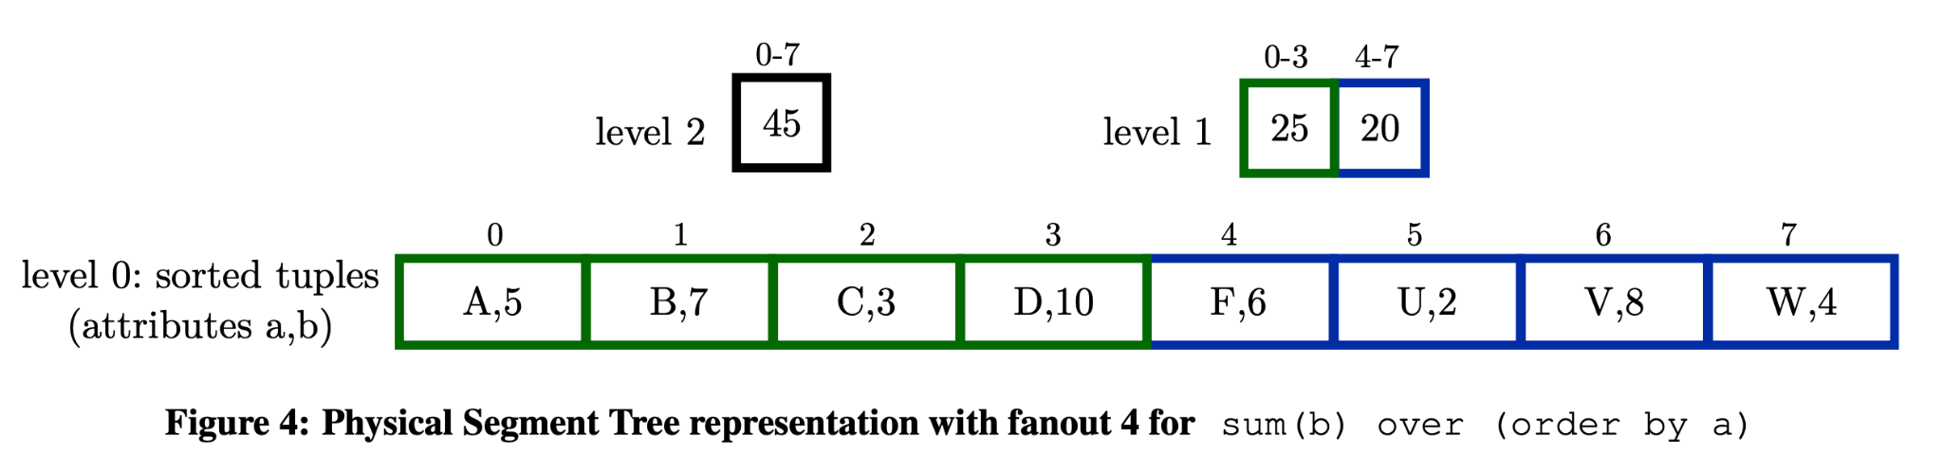
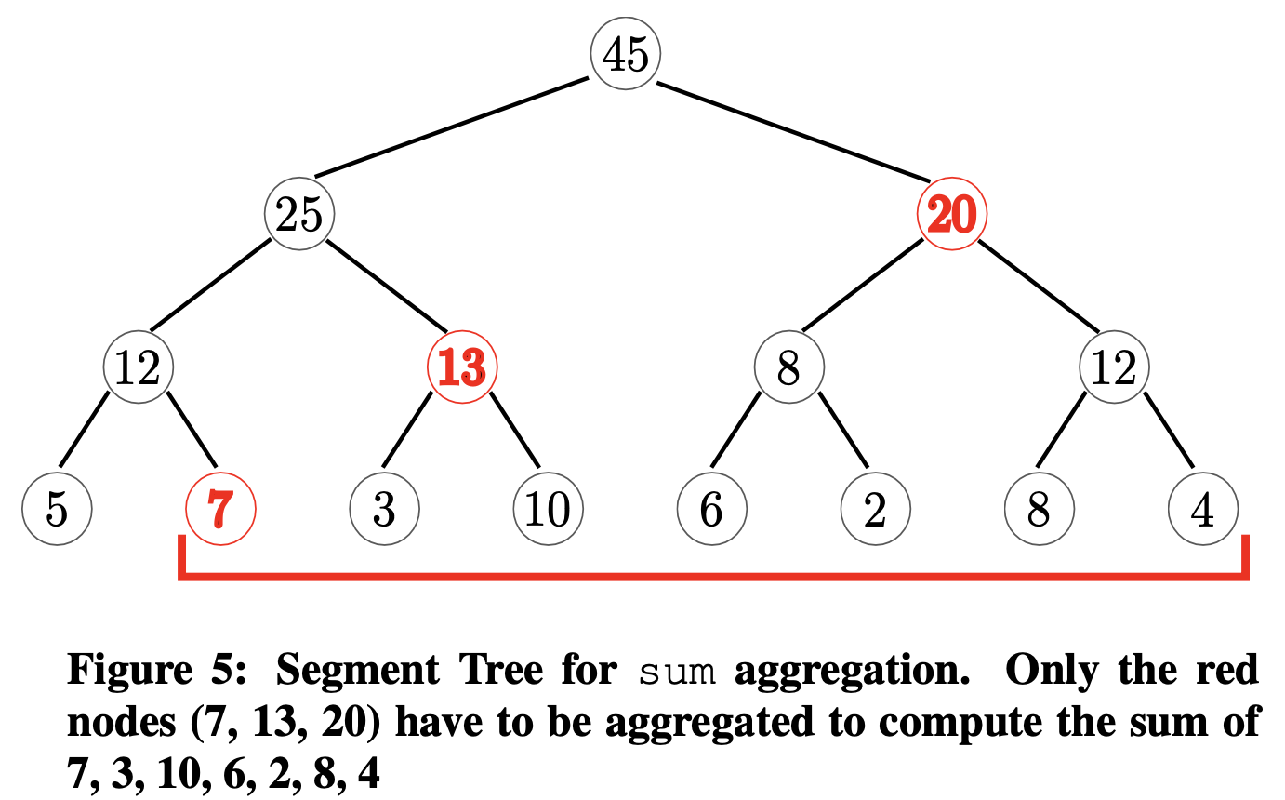
Framing: Segment tree / Leis et al. VLDB’15
For removable cumulative aggr fn. → reduced the computation.
Store aggregate function for sub-ranges

Slide 9
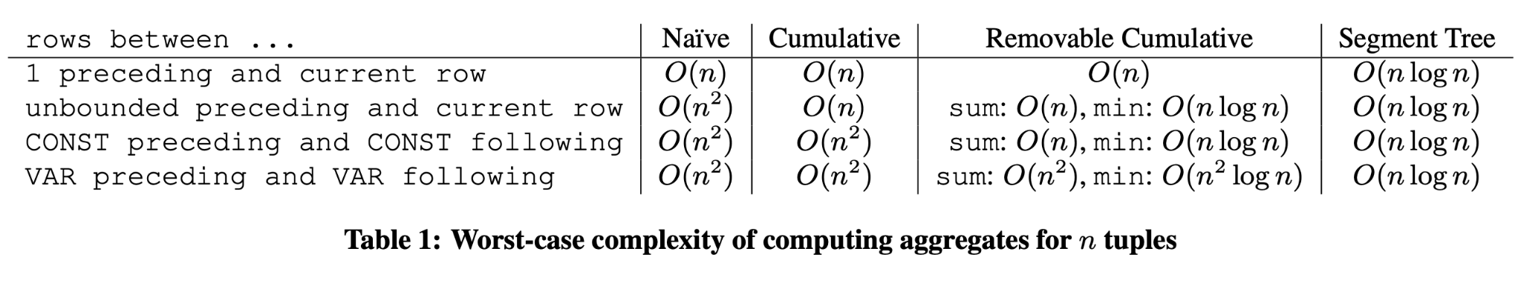
Framing: Complexity / Leis et al. VLDB’15
“Intuitively, the Segment Tree approach is only beneficial if the frame frequently changes by a large amount in comparison with the previous tuple’s frame.”

Slide 10
Note on the next few slides
Window aggregations are also used in other settings, especially streaming data platforms, such as Azure Stream Analytics.
The next few slides discuss what window aggregation look like in the streaming data platform world.

Slide 11
In the streaming land … different emphasis … not SQL
Streaming systems (not SQL warehouses) have window queries too, but use it in a different context.
Focus largely on time/sequence based orders, and more “natural” streaming operations.
Focus of these systems is on streaming applications, so run these window queries on a continuous stream (internally they may land the data for a small amount of time).
Five Types of Windows
Tumbling
Hopping
Sliding
Session
Snapshot

Slide 12
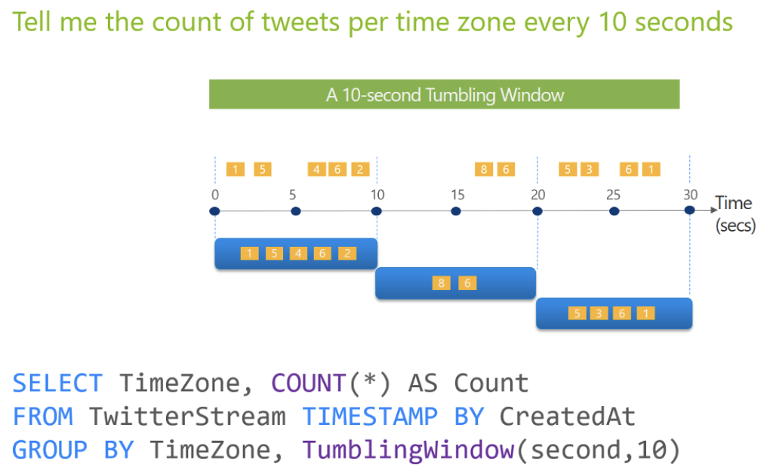
In the streaming land: Tumbling
Credit: Azure Streaming Documentation

Slide 13
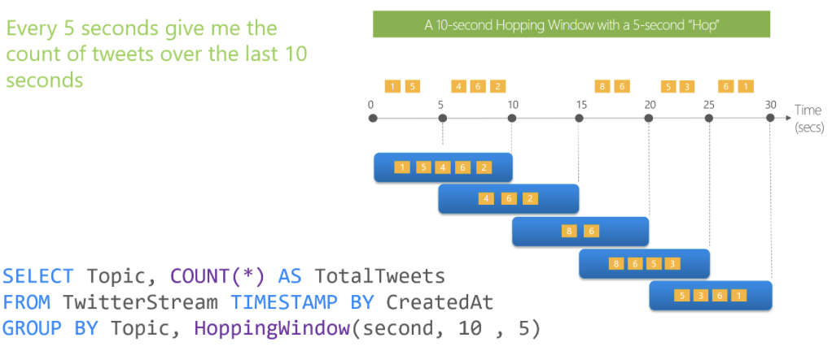
In the streaming land: Hopping
Credit: Azure Streaming Documentation

Slide 14
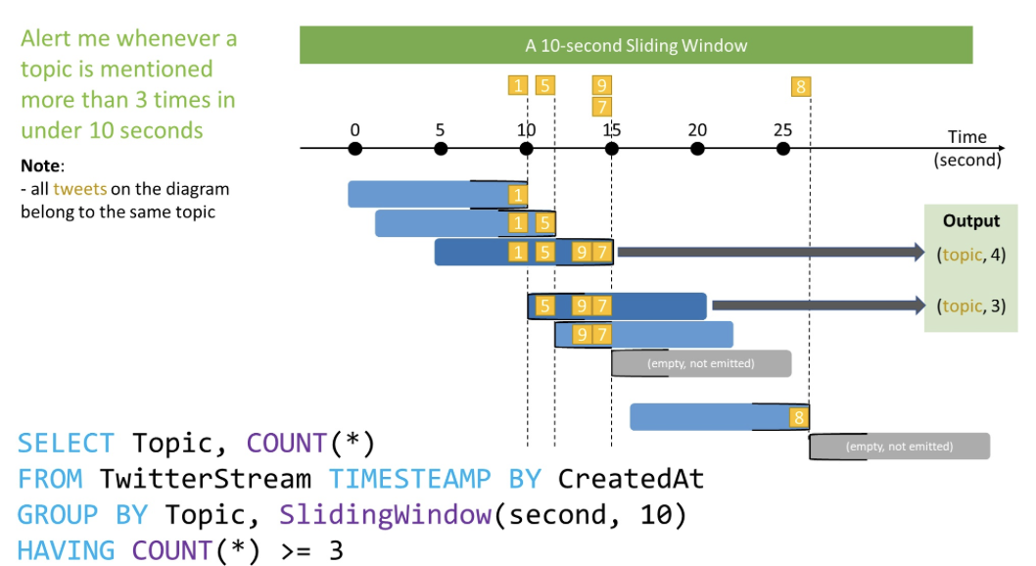
In the streaming land: Sliding
Credit: Azure Streaming Documentation

Slide 15
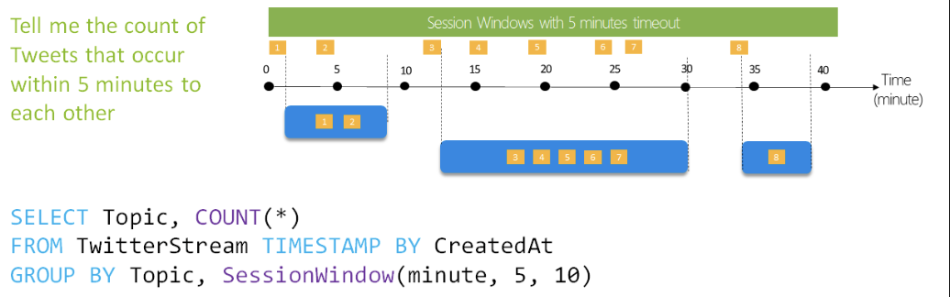
In the streaming land: Session
Credit: Azure Streaming Documentation

Slide 16
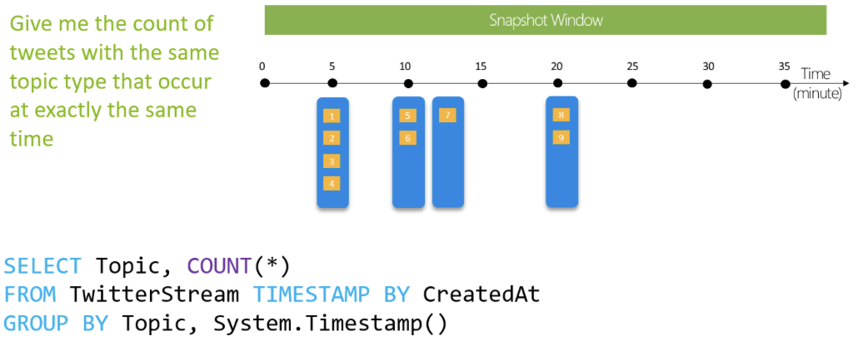
In the streaming land: Snapshot
Credit: Azure Streaming Documentation

